Slide 1
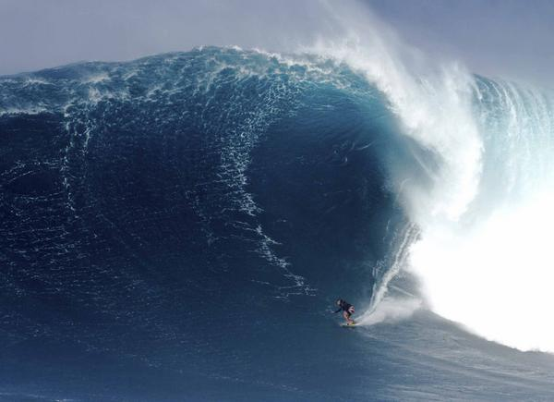

Waves & Surfing Surfboard Design and Geometry Power Generation from Waves Tsunamis Sharks Ships

Slide 2
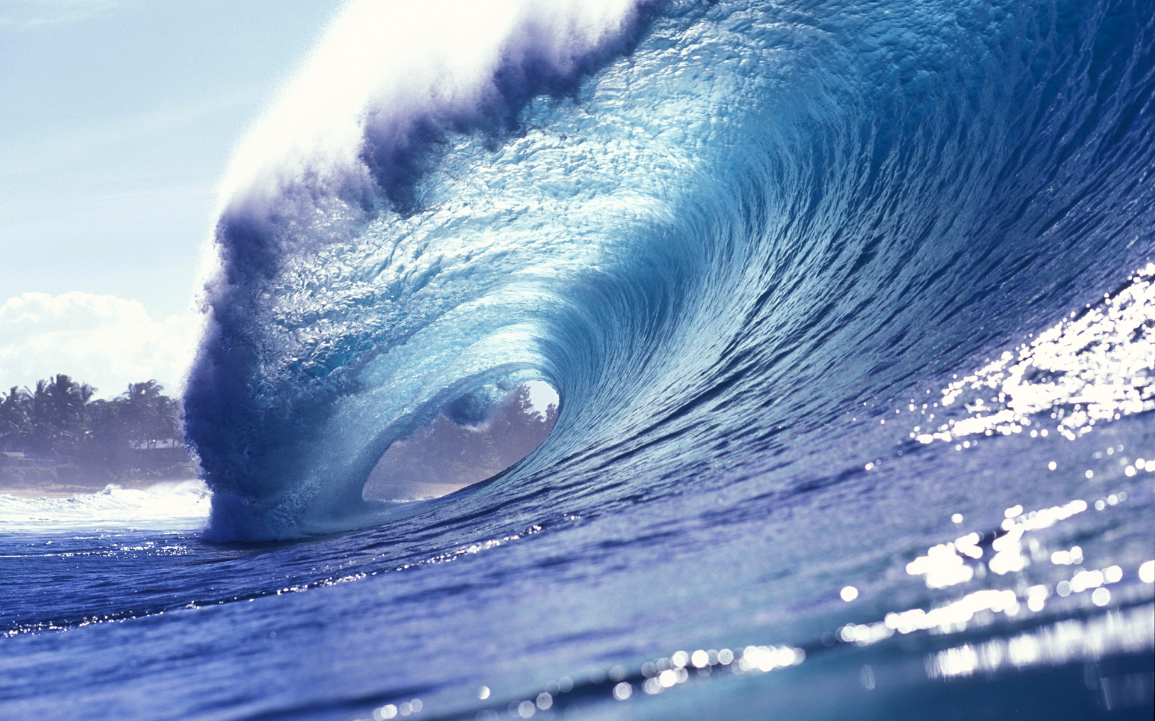


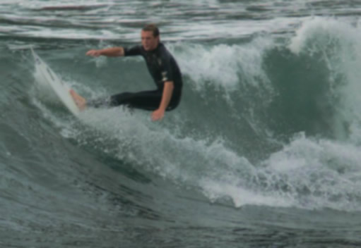


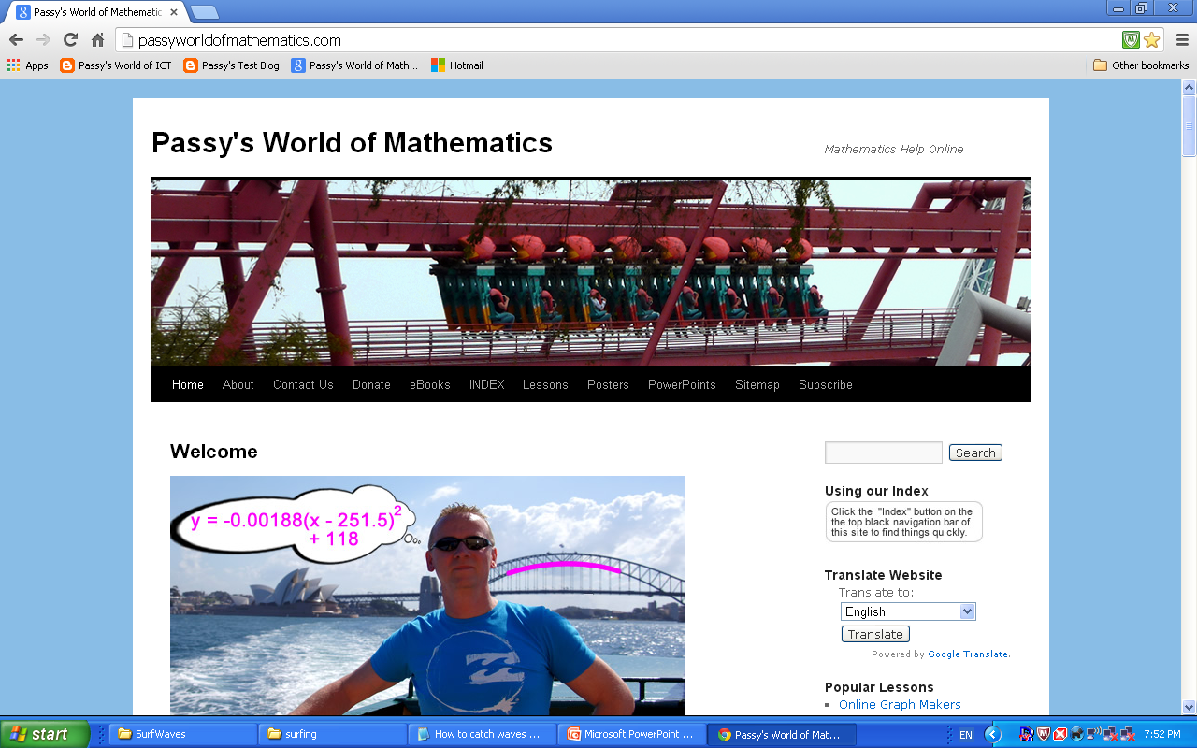
Paul Pascoe

Slide 3
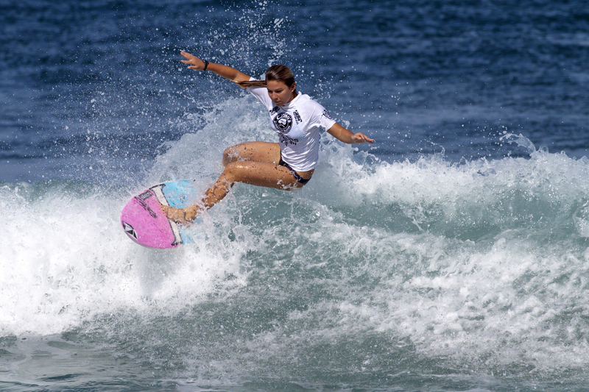
Mathematics of Surfing
Image Purchased by Passy’s World from Dreamstime.com

Slide 4
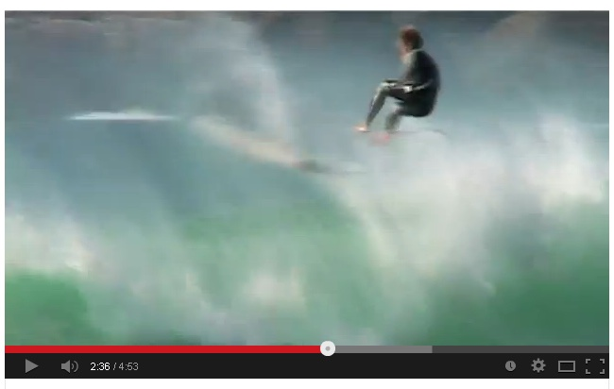
Intro Video
Surfing Miscalculations and Random Events
Source: http://www.youtube.com/watch?v=Fp5Ds_6ck5s

Slide 5
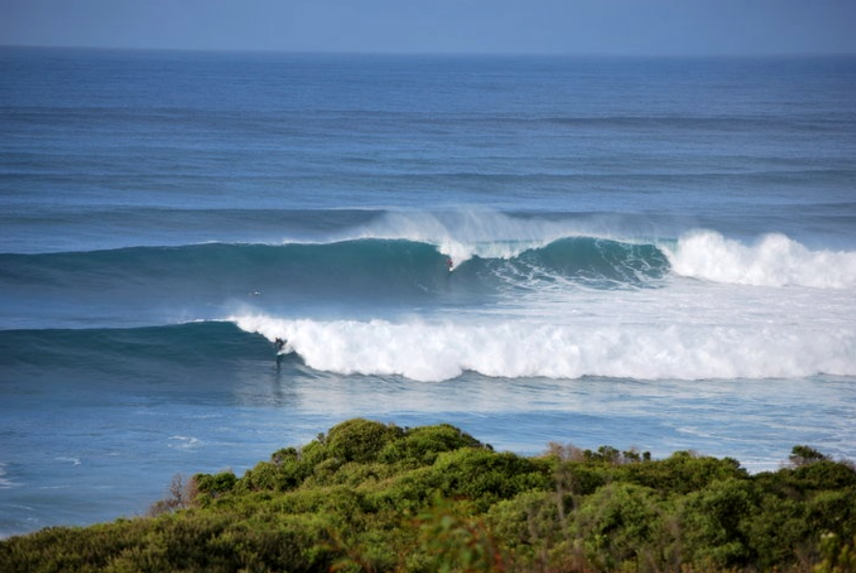
Mathematics of Surfing
What Causes Water Waves
Predicting Large Waves
Breaking Waves
Wave Speed Equations
Effect of Sea Floor
Parts of a Breaking Wave
Catching and Riding a Wave
Artificial Surf Breaks

Slide 6
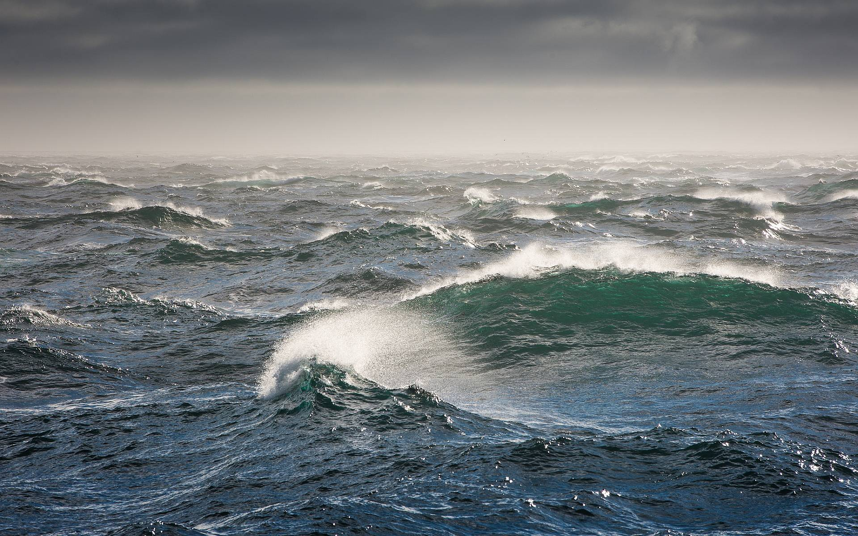
What Causes Water Waves
Image Source: http://www.culut.com
When wind blows over the vast expanses of open
water, it transfers energy to the water surface and creates water waves. Surf Waves come from Ocean Storms.

Slide 7
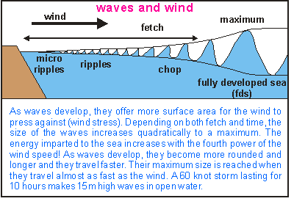
What Causes Water Waves
Wave Energy = Wind Speed x Wind Duration x Fetch Distance
Image Source: http://www.seafriends.org.nz

Slide 8
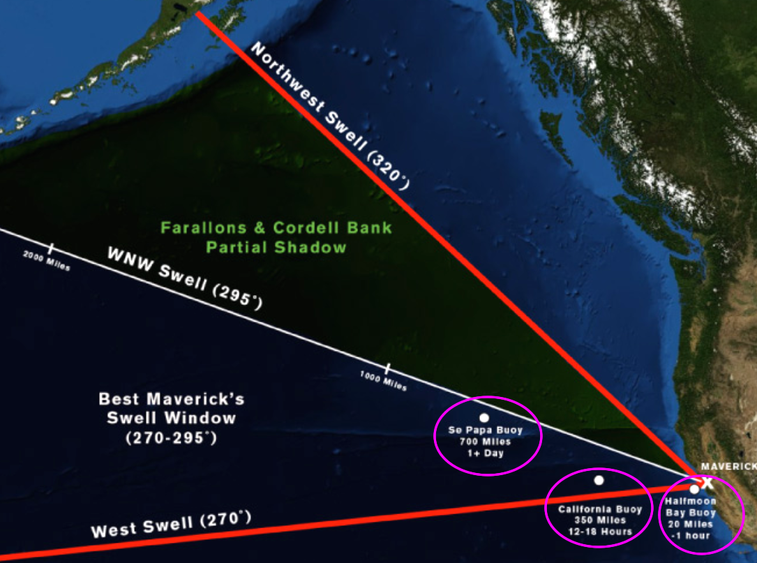
Predicting Large Waves
What Causes Water Waves
Image Source: Mechanics of Mavericks at http://www.surfline.com

Slide 9
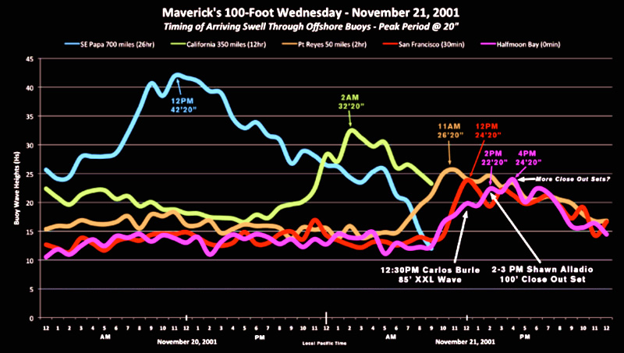
Predicting Large Waves
What Causes Water Waves
Image Source: Mechanics of Mavericks at http://www.surfline.com

Slide 10
Breaking Waves
What Causes Water Waves
Bells Beach : http://magicseaweed.com

Slide 11
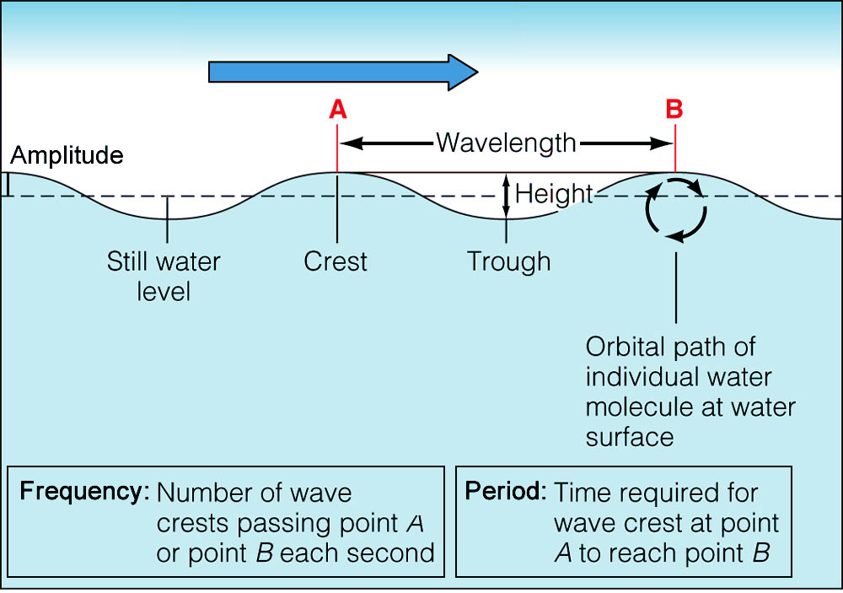
Deep Water Waves
What Causes Water Waves
Original Image Source: http://science.kennesaw.edu

Slide 12
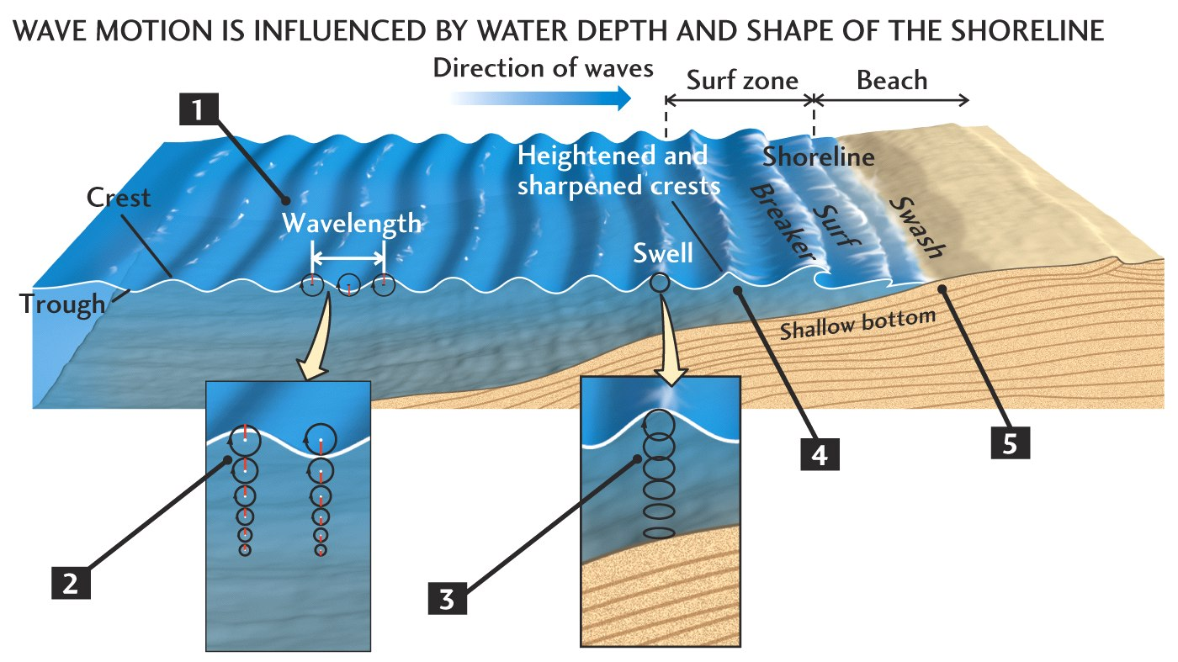
Water Wave Motion
In water waves, (in open water) :
The energy travels but the water does not
Original Image Source: http://bc.outcrop.org

Slide 13
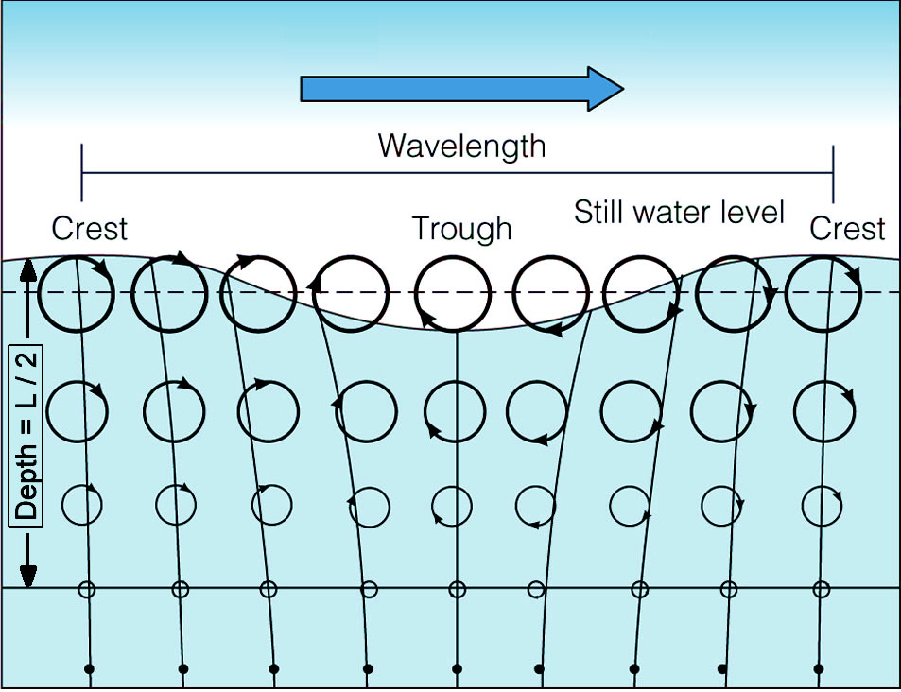
Water Wave Motion
Water Particles subjected to wave energy, move in elliptical motions, which decrease to zero with depth.
Original Image Source: science.kennesaw.edu

Slide 14
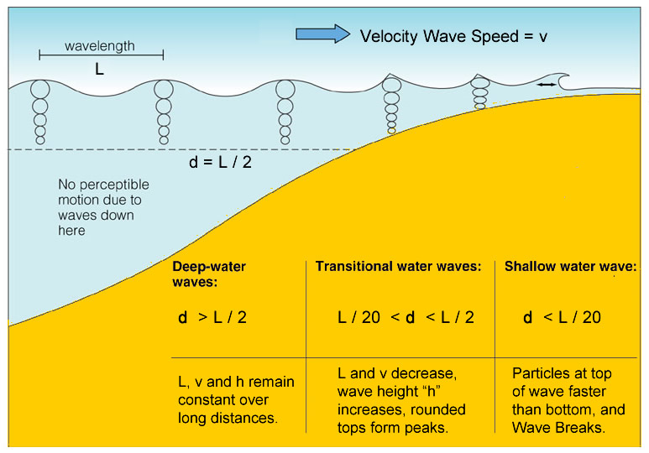
The Three Wave Zones
Deep Water Waves “BREAK” into Shallow Whitewater
Original Image Source: science.kennesaw.edu

Slide 15
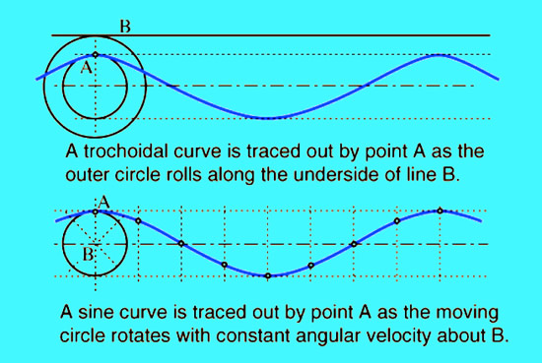
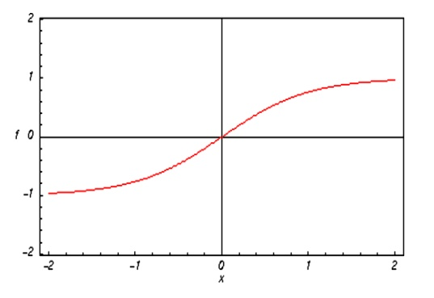
Water Wave Equations - Shape
The shape of water waves is not Sinusoidal, it is actually “Trochoidal” (like a Hyperbolic Tan Graph)
BUT - Deep Water waves are approximately Sinusoidal
Original Image Source: http://hyperphysics.phy-astr.gsu.edu

Slide 16
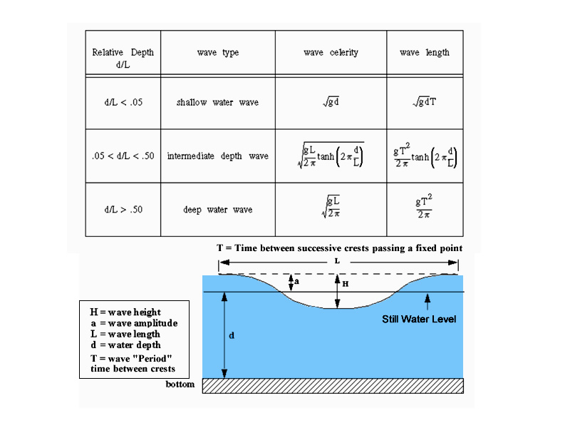
Three Zone Waves - Speed Equations
“Celerity” - c - for Deep, Transitional, and Shallow
Original Image Source: http://scubageek.com

Slide 17
Three Zone Waves - Speed Equations
Notes about the three equations
- Wave Period is always constant : T is independent of d.
As a result, in Deep Water the wavelength “L” is constant
and T is constant, so the Speed is also constant.
- In shallow water L decreases as the square root of
Depth, but “T” remains the same; so the wave speed
decreases as the square root of gravity x water depth.
- If we substitute the values of Wavelength, Depth, and
T = 10 mins, d=4000m, L =200000m for Tsunami Waves,
we find that Relative Depth is d/L < 0.05 or d/L < 1/20
which Mathematically classifies them shallow water waves.

Slide 18
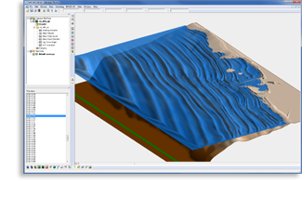
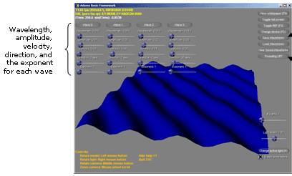
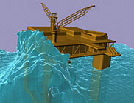
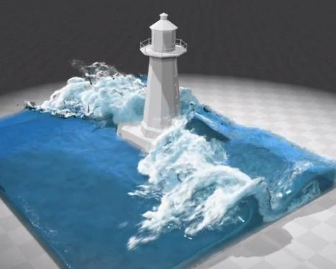
Computer Modeling Waves
Computer Modeling of Waves can be used as part of designing breakwaters, marinas, light houses, oil rigs, ships,
tourist resorts, water fun parks, and artificial surf reefs.
Original Images Source: Google Images

Slide 19
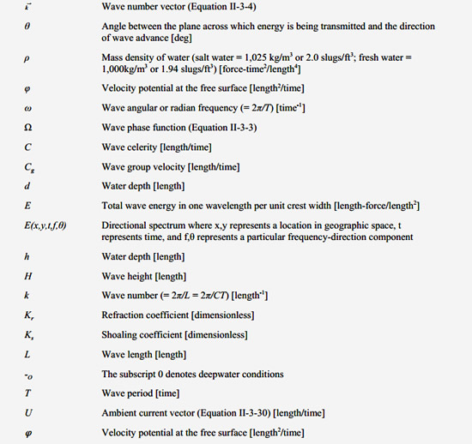
Computer Modeling - Variables
RCPWAVE Computer Model Variables:
Source: US Army Coastal Engineering Manual

Slide 20
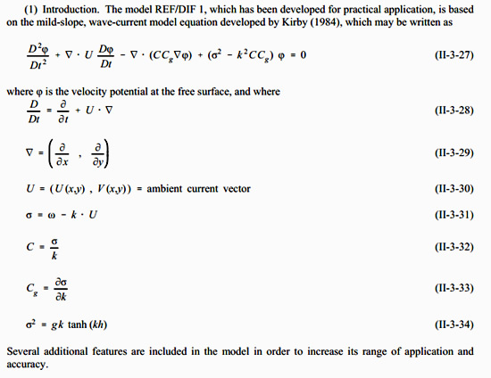
Computer Modeling - Equations
RCPWAVE Computer Model Equations
Source: US Army Coastal Engineering Manual

Slide 21
Computer Modeling Waves
Real Wave Equations like REF/DIF1 are programmed into
Computer Apps, where we can add bathymetry data, and then adjust Equation Parameters, and view resultant effects.
Original Images Source: Google Images

Slide 22
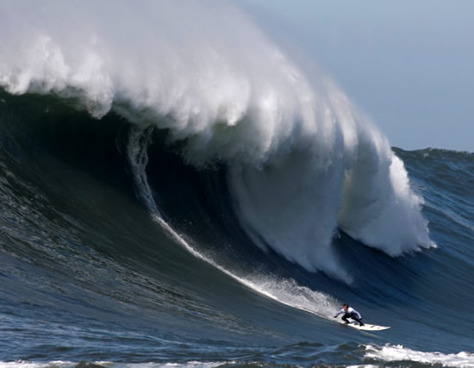
Effect of Sea Floor
The shape of the Sea Floor, (called “Bathymetry”),
plays a big part in forming surfable breaking waves
Source: Mechanics of Mavericks at http://www.surfline.com

Slide 23
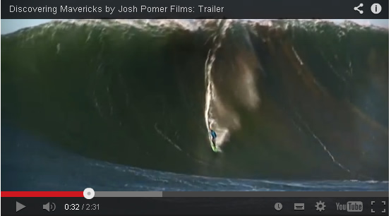
Effect of Sea Floor
Mavericks Surf Break in Northern California
Source: http://www.youtube.com/watch?v=KMlZM9kDpMc

Slide 24
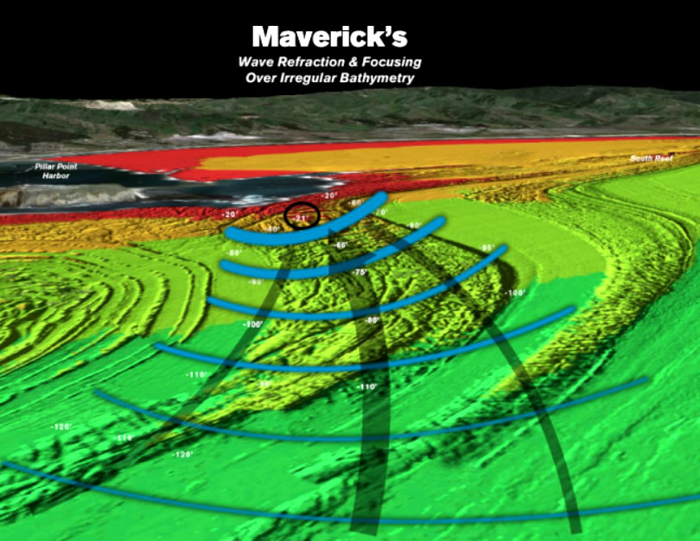
Effect of Sea Floor
Mavericks – Power, Steep Reef, Parabolic Refraction, Grooves
Source: Mechanics of Mavericks at http://www.surfline.com

Slide 25
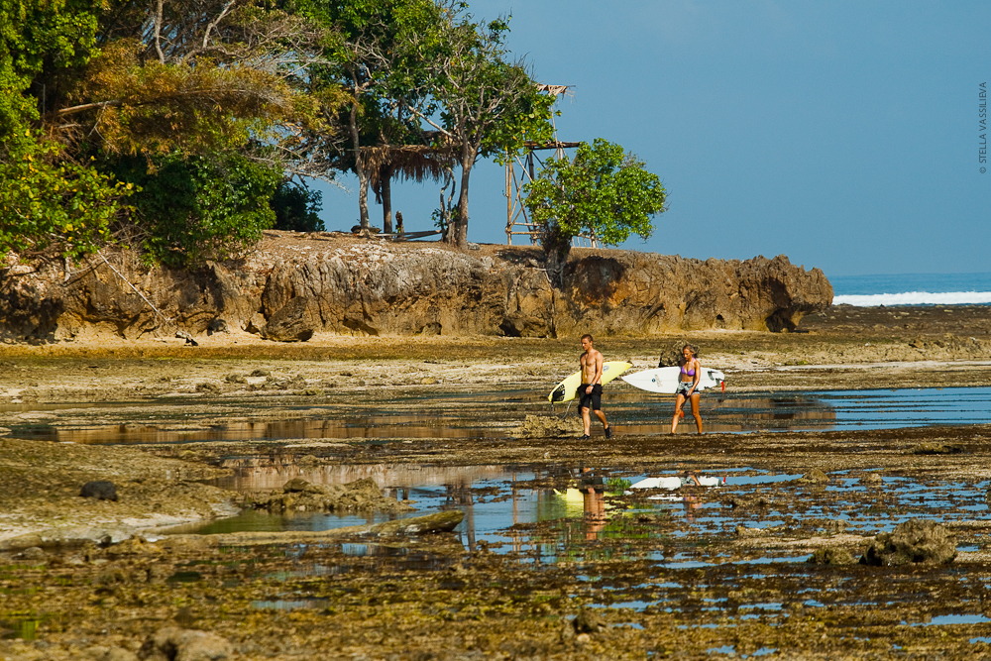
Effect of Tides
Tides change the water depth, and so the bathymetry at a particular surf break varies over the tidal period.
Image Source: http://photo.stellav.ru

Slide 26
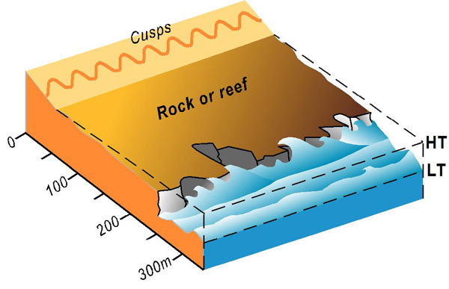
Effect of Tides
The sea floor shape may be perfect at high tide and produce fabulous waves, but at low tide the waves are breaking on a different part of the sea bed resulting in unsurfable waves.
Image Source: http://www.ozcoasts.gov.au

Slide 27
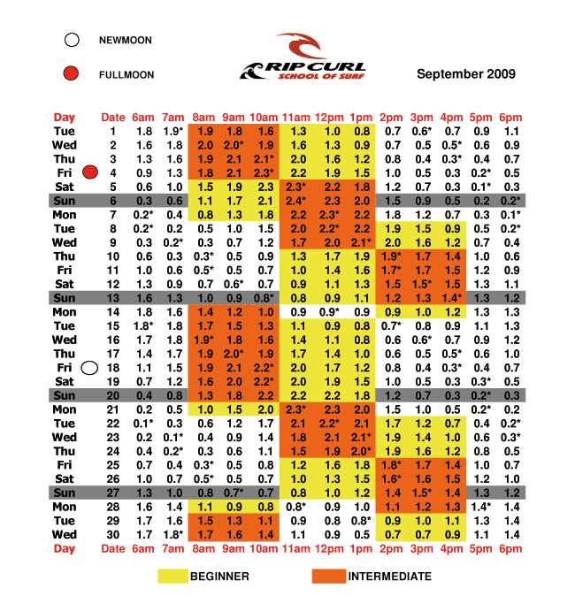
Effect of Tides
Surfers use Data arranged in Tables called “Tide Charts”.
Image Source: http://www.blueoasisbeachclub.com

Slide 28
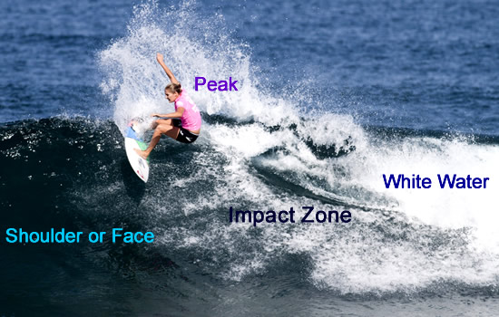
Parts of a Breaking Wave
Catch in the Impact Zone, Ride along the Shoulder
Original Image Purchased by Passy’s World from Dreamstime.com

Slide 29
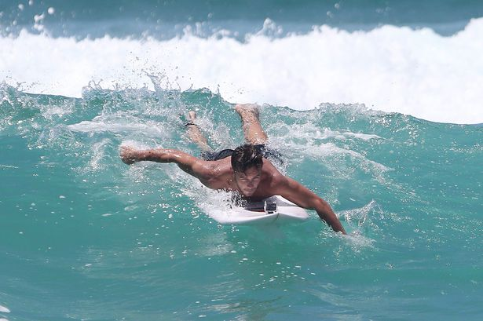
Catching a Wave
Surfer Momentum must ≈ Wave Momentum
Image Source: http://i3.mirrror.co.uk

Slide 30
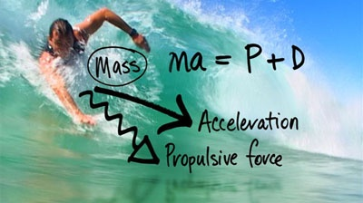
Catching a Wave - The Equation
When you Paddle, the Forces involved are as follows:
( of surfer )
D = Assistive Drag force of the wave.
Original Image Source: www.abc.net.au
You must produce enough acceleration to get your
speed as close as possible to the wave’s speed.

Slide 31
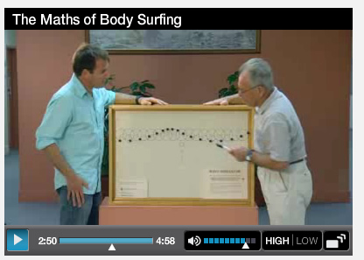
Professor Neville de Mestre VIDEO
The “ma = P + D” equation is from the following video
featuring Professor Neville De Mestre.
Source: http://www.abc.net.au/catalyst/stories/2377157.htm

Slide 32
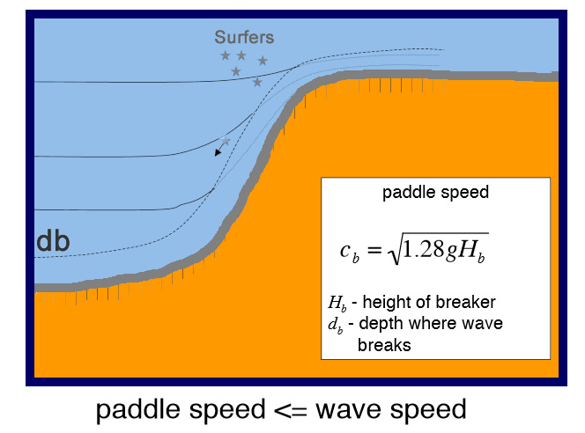
Paddle Speed Equation
Professor David Sandwell’s Equation
Catching the Wave on a Surfboard (Aerial View)
Original Image Source: http://topex.ucsd.edu

Slide 33
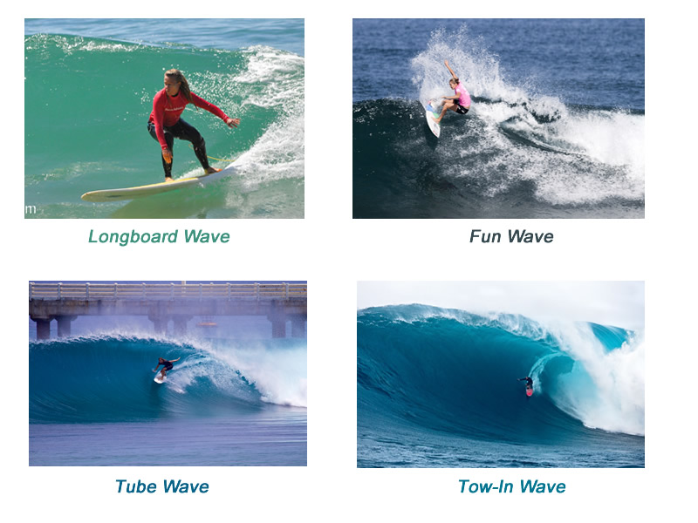
Types of Surfing Waves
Based on Size, there are four main types of Breaking Wave associated with Surfing.
Original Images Source: Google Images

Slide 34
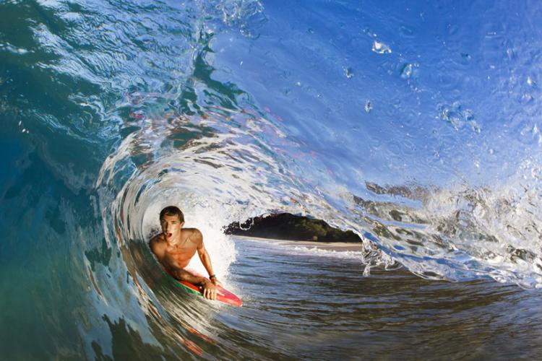
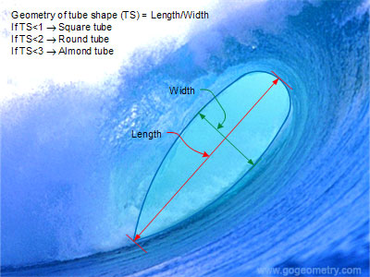
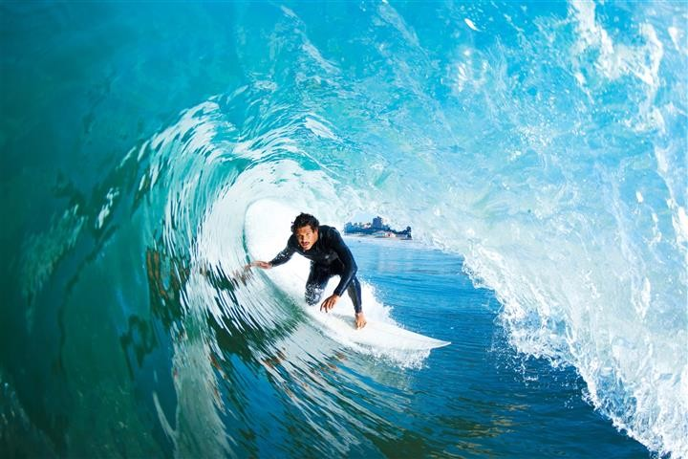
Geometry of The Tube Wave
A Geometrical Ratio is used to Describe Tube Waves
Original Images Source: Google Images

Slide 35
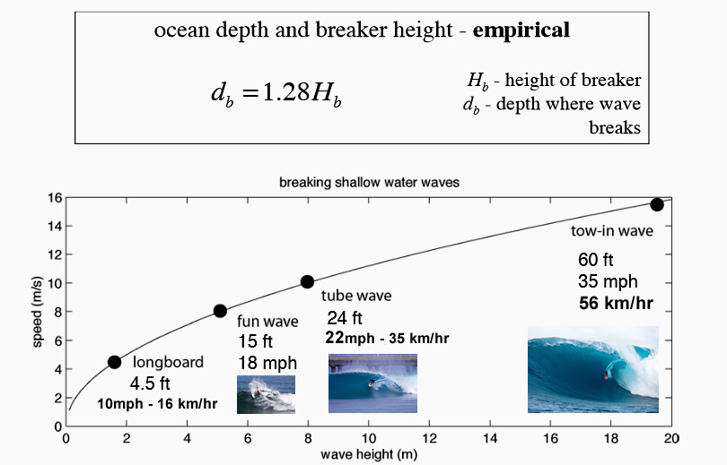
Ocean Depth, Breaker Height, and Wave Speed
David Sandwell – http://topex.uscd.edu

Slide 36
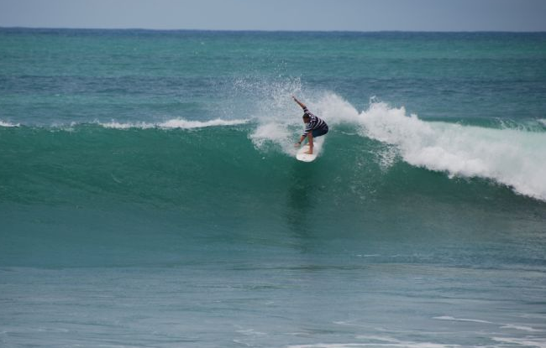
Dropping In
It is impossible to paddle at the speed of big waves
to catch them directly; and so “Dropping In” is used.
Image Source: http:govisitcostarica.com

Slide 37
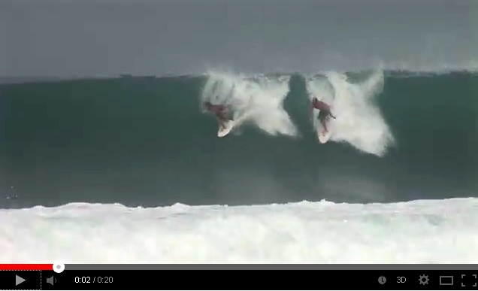
The other “Dropping In”
“Dropping In” also means stealing another surfer’s wave by not giving way via the “Inside Rule”.
Source: http://www.youtube.com/watch?v=S8f9HVvezMQ

Slide 38
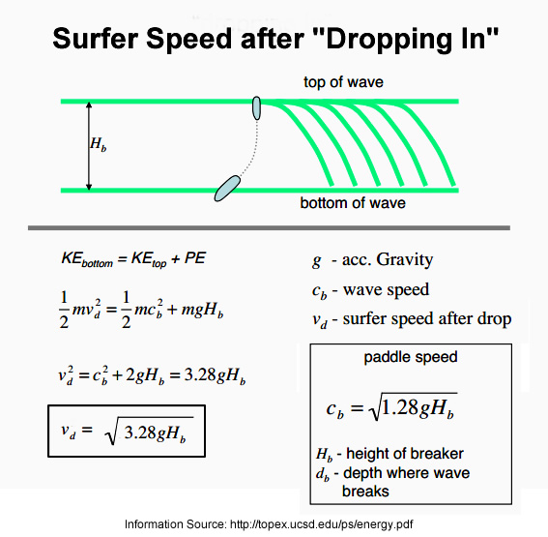
Speed Gain by Dropping In

Slide 39
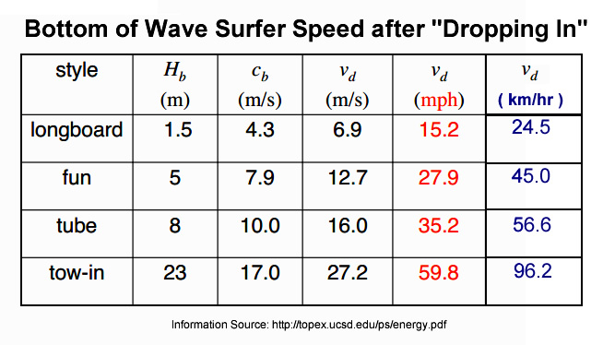
Speed of Standard Wave Types
“Dropping In” produces these bottom of wave
speeds for the four standard wave types.

Slide 40
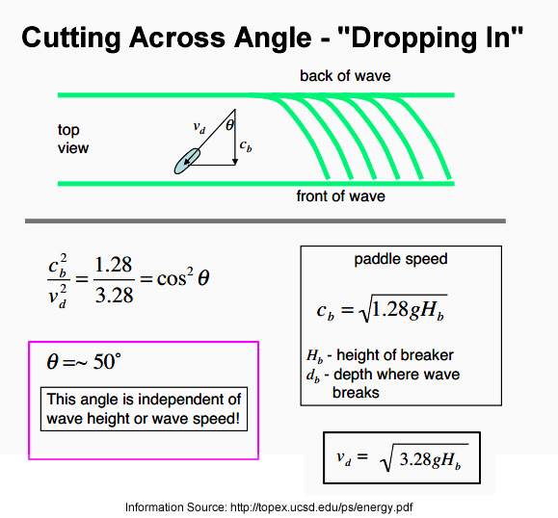
Dropping In Angle

Slide 41
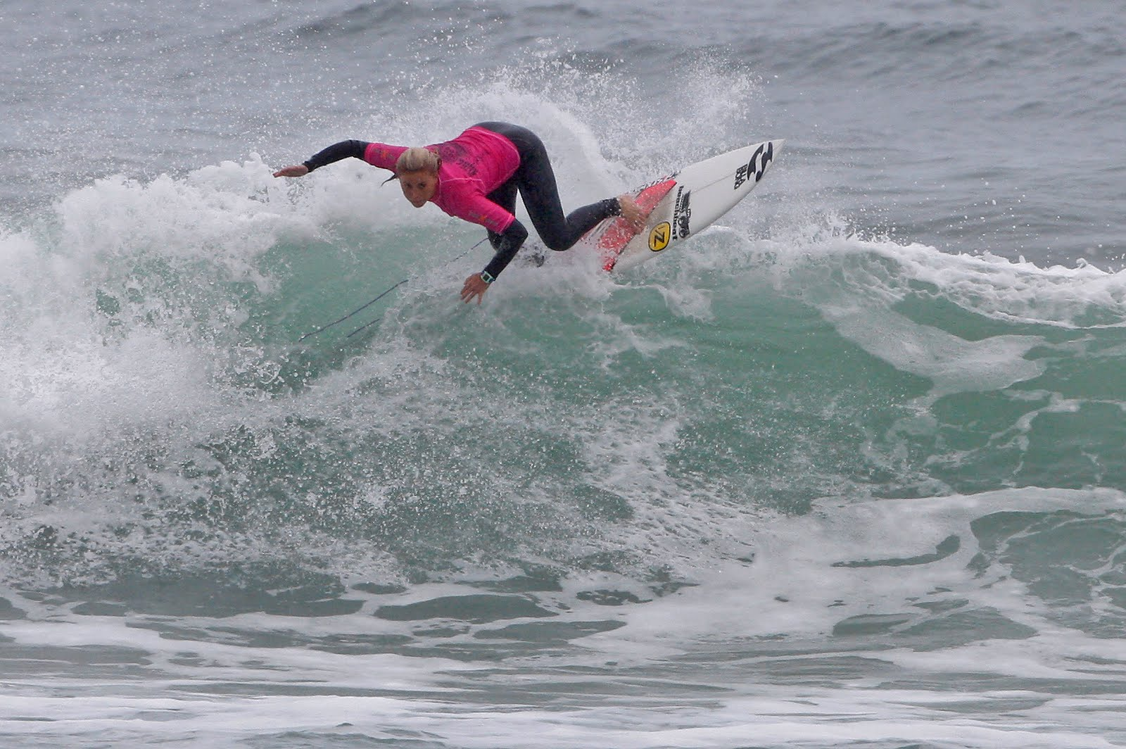
Surfing the Wave
Riding the Wave - up and down and turn around
Image Source: http://picasaweb.google.com

Slide 42
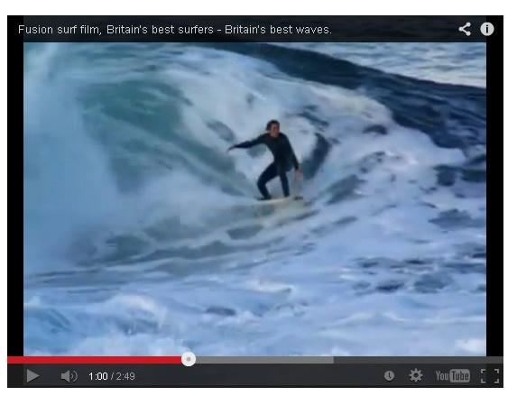
Surfing the Wave
Examples of Riding the Wave and Manoeuvres
Source: http://www.youtube.com/watch?v=O_oADJ961vo

Slide 43
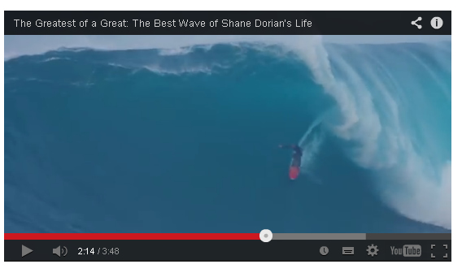
Surfing Giant Waves
Very high speed only allows basic manoeuvres.
Source: http://www.youtube.com/watch?v=O9crPOB_9tE

Slide 44
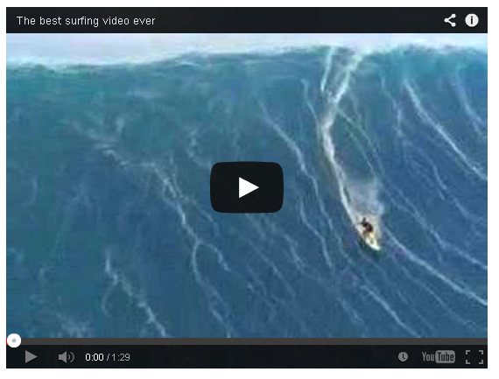
Tow-In Surfing for Huge Waves
A Jet Ski Tow-In gives enough speed to “safely” catch gigantic size fast waves. (35mph / 66km/hr)
Source: http://www.youtube.com/watch?v=3oS_28utt2Y

Slide 45
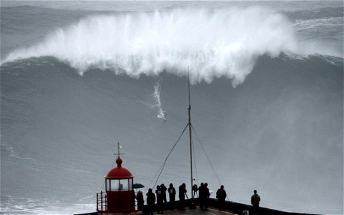
Biggest Wave Ride – 100 ft / 30m
Nazarre Portugal – Surfers : Brazilian and American
Image Source: http://i.telegraph.co.uk

Slide 46

Nazzarre Portugal – Bathymetry
Huge Underwater Canyon that the water is channeled
Along, but then suddenly bottoms out near the shore.
Image Source: http://i.ytimg.com

Slide 47

Other Surfing Statistics
Original Image Source: science.kennesaw.edu

Slide 48

Artificial Surfbreaks
Narrowneck, Queensland, Australia Cables, Western Australia, Australia Pratte’s Reef, El Segundo, California, Los Angeles Bagarra, Queensland, Australia
Mt Manganui, NZ Bornemouth, UK Kovalam, India
Image Source: http://surfspotsmap.com

Slide 49

Artificial Surfbreaks
Artificial Reef in Kovalam, India
Source: http://www.youtube.com/watch?v=mGYuj-Ow1rk

Slide 50

Continuous Waves
Can occur in Rivers and Water Parks
Source: http://www.youtube.com/watch?v=ljVbieeFn14

Slide 51

Surf Aid Mathematics Resorces
http://www.surfaidinternational.org/schoolsprogram

Slide 52
Mathematics of Surfing
Complete details of all material covered
in this presentation can be found in the
“Mathematics of Oceans” lesson on the
Passy’s World of Mathematics Website:
www.passyworldofmathematics.com

